Slide 1

REPORT ON CRUD OPERATIONS
NAME : VARADHA . N
UID : 161101
MAIL ID : varadha.nair@ust.com

Slide 2
MONGO DB
MongoDB is an open-source document database and leading NoSQL database.
MongoDB is a cross-platform, document oriented database that provides, high performance, high availability, and easy scalability. MongoDB works on concept of collection and document.

Slide 3
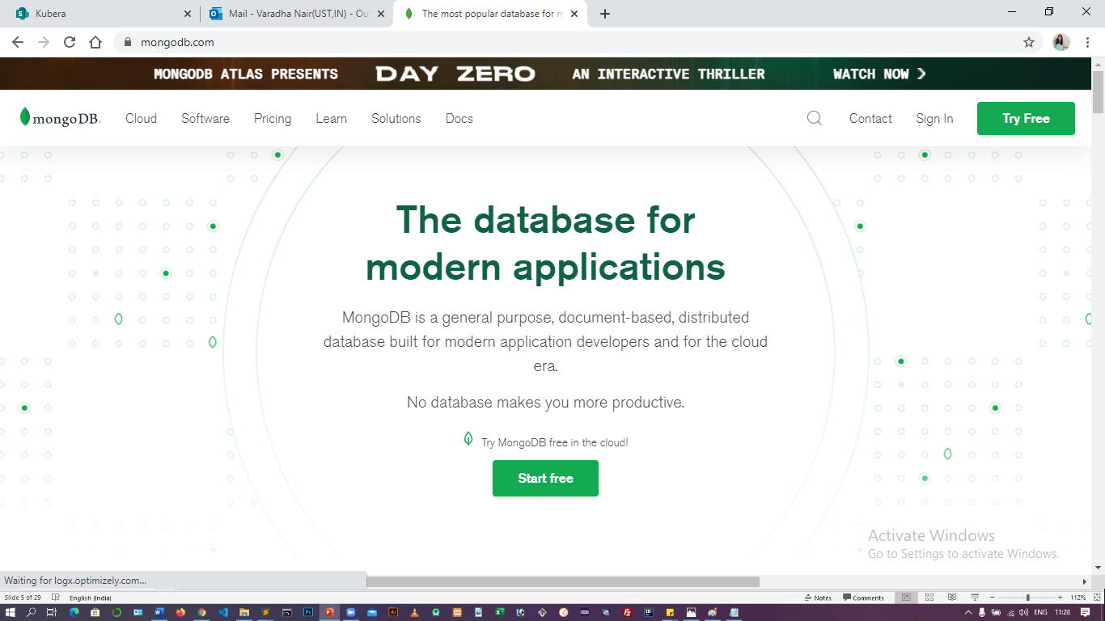
From google search mongo db.

Slide 4
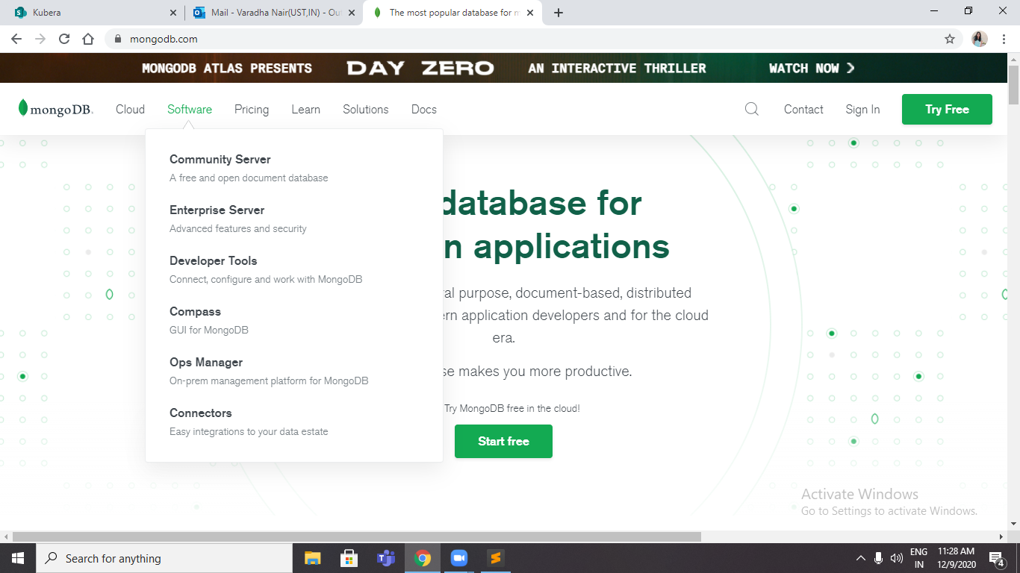
In that click software

Slide 5
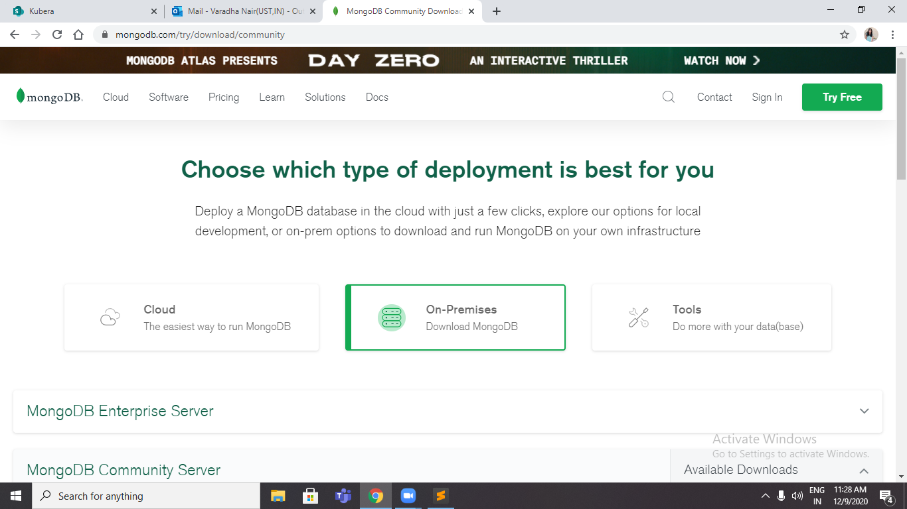
From software click community server

Slide 6
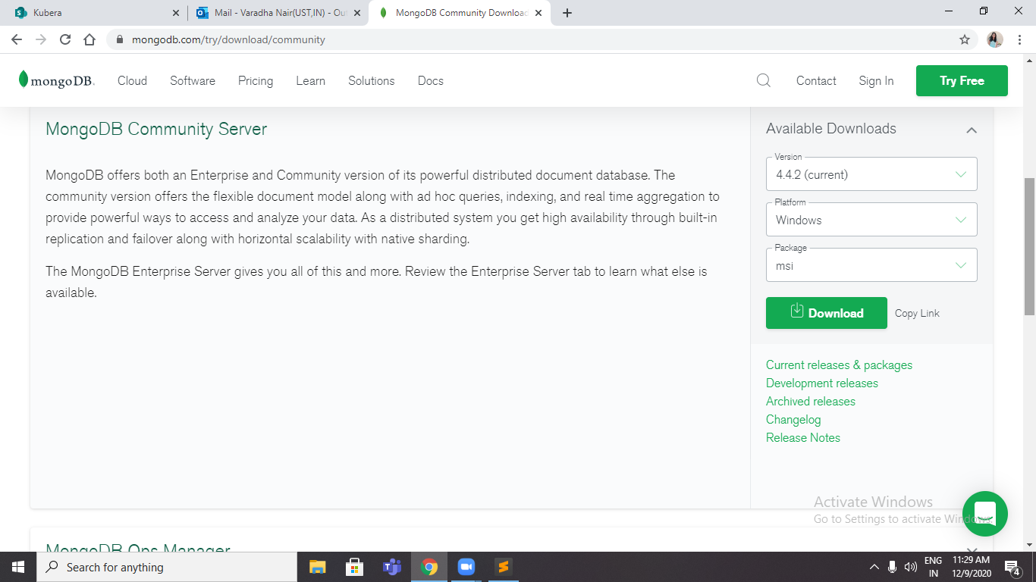
Now download the MONGO DB

Slide 7
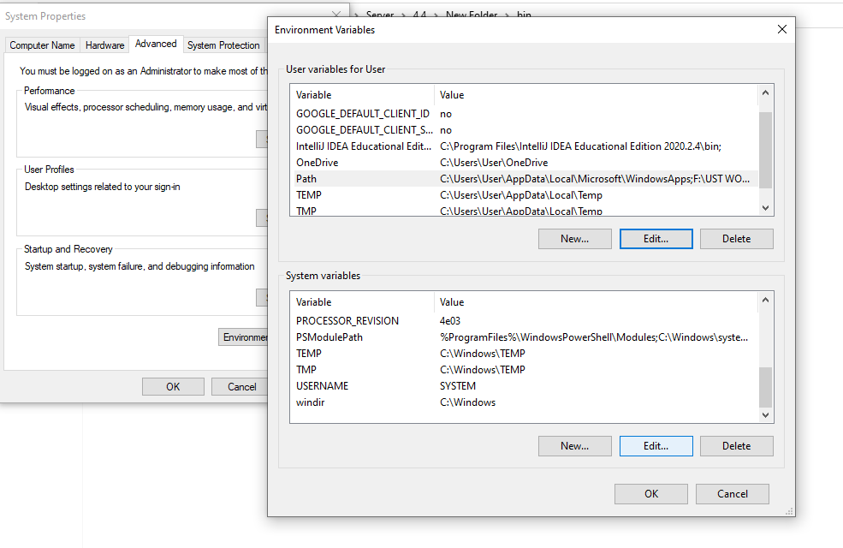
Now after downloading, install and set the necessary path for the operations

Slide 8
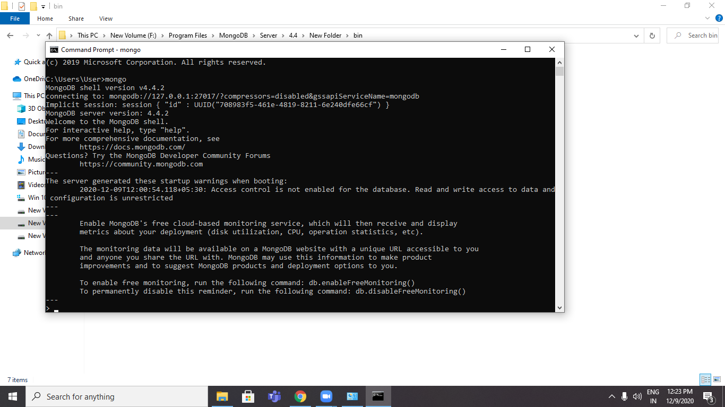
After installing the mongo dB then open the command prompt and enter mongo

Slide 9
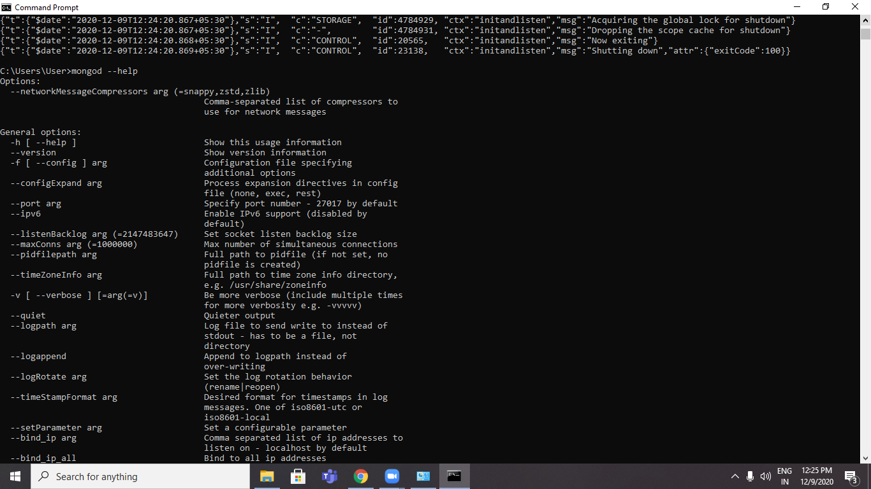
Then we can check whether all the files are installed or not by mongod --help

Slide 10
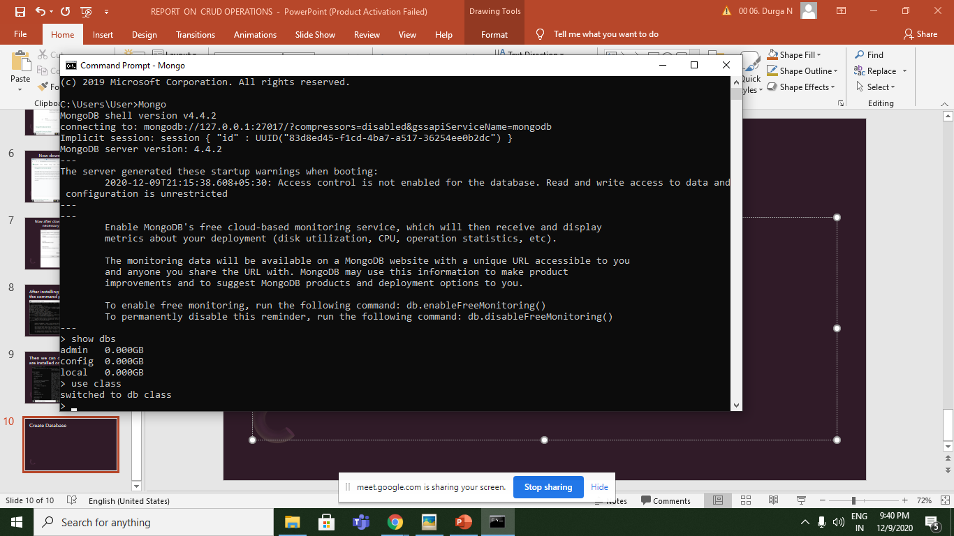
Create Database -> use class

Slide 11
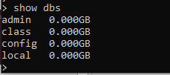
Display Database -> show dbs.

Slide 12
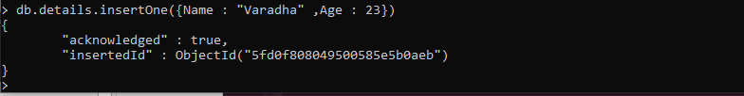
Create Collection -> db.details.insertOne({Name: “Varadha”,Age: 23})

Slide 13
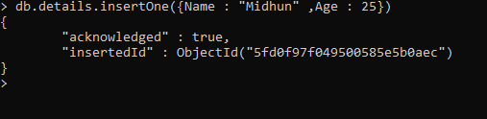
Insert one document

Slide 14
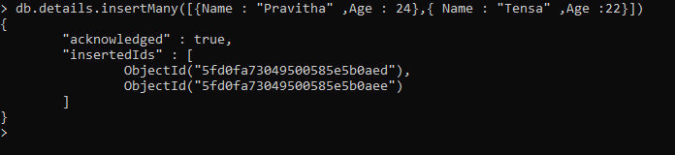
Insert Many Documents

Slide 15
Insert Document with custom ID

Slide 16
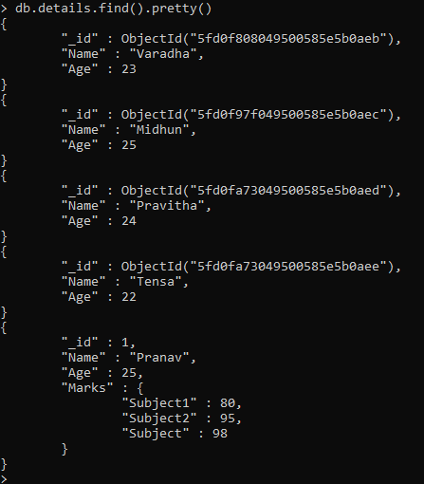
Read All Data's

Slide 17
READ BASED ON CONDITIONS

Slide 18

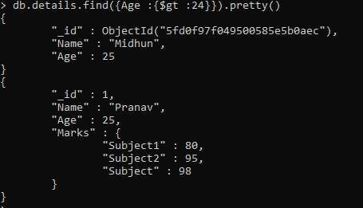

Slide 19
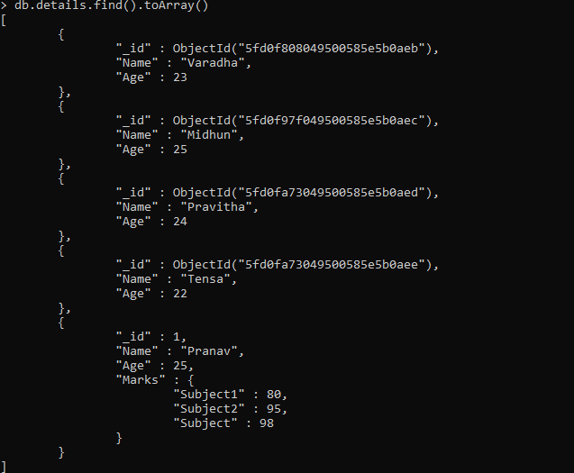
READ AS ARRAY

Slide 20
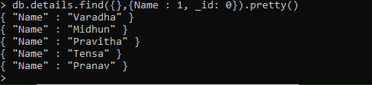
Read a single Field from data

Slide 21

Read Field Value from a document

Slide 22
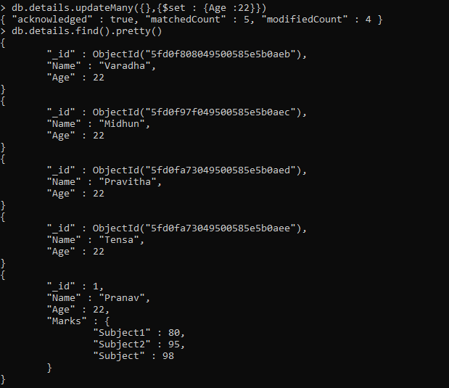
updateMany Details

Slide 23
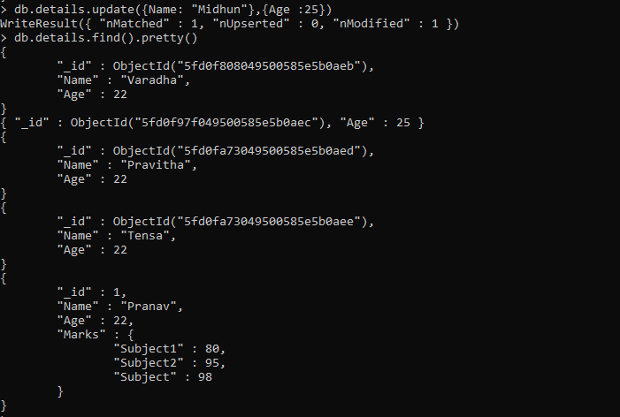
Update on document

Slide 24
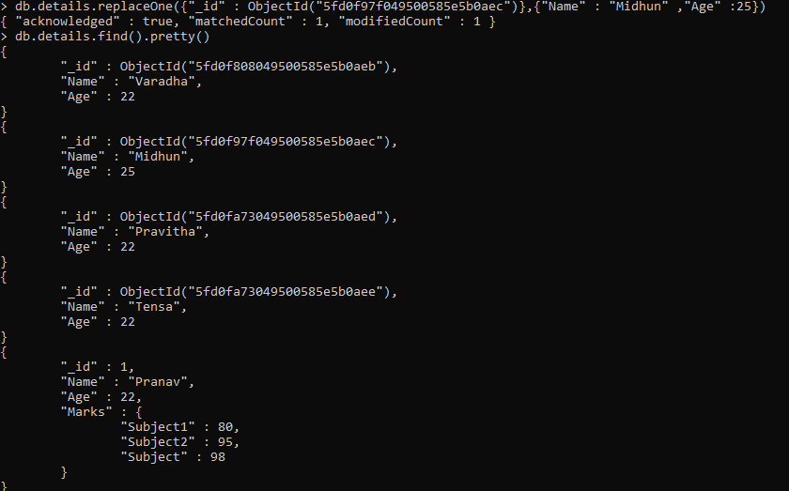
ReplaceOne on documents

Slide 25
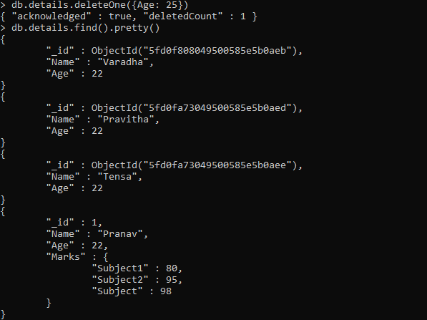
deleteOne on Documents

Slide 26

deleteMany on Documents

